Slide 1

Reinforcement Learning With Games
1
Eoghan Casey
15160513

Slide 2
Contents
2
Overview
Objectives
Background
Work to Date
Demo Week

Slide 3
1. Overview
3
My Final year project is the investigation of the use of Reinforcement learning in games.
Reinforcement learning is learning what actions to take through the use of a rewards system. In other words becoming better at the given task through trial and error, with positive rewards for good actions and penalties for bad actions.
In relation to games it would be making the move which will bring you to or closer to the goal state, this would be a positive action.
I will be mainly focusing on Checkers for my project but will look into other games for comparison.

Slide 4
2. Objectives
4
To compare and contrast machine learning algorithms used by reinforcement learning in games.
Such comparisons would include:
  -compute time
  -learning time
  -efficiency (i.e win rate)
  -memory usage etc.
To create an implementation of a scaled down Checkers board which uses reinforcement learning to achieve a strong standard of play.

Slide 5
3. Background
5
Checkers has 5x10^20(500 billion) different possible board states.
It is a solved game through the use of reinforcement learning. If both players were to play optimal with would end in a draw.
The Chinook team in 2007 completed computations that had been running continuously for 18 years, stating that their system could at minimum always achieve a draw.[Checkers is solved, 2007, Jonathan Schaeffer]
Checkers is possibly the most complex game that has been solved using machine learning techniques.

Slide 6
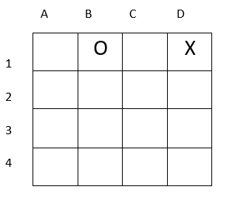
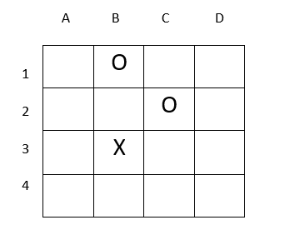
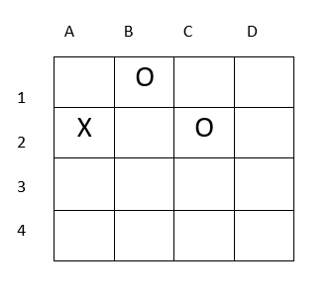
4. Work to Date – RL
6
How is Reinforcement learning implemented?
+1
0

Slide 7
4. Work to Date
7
Temporal Difference Learning:
  -Evaluates states by comparing the difference between the current state and its successive/next state.
  -The measure of these states periodically update rather than all at once, giving the computer an easier compute time.
  TD(0) :
  -V(St) ← V(St) + α[Rt+1 + γV(St+1) − V(St)]
Value of current state
Rate of Learning
Value of next state
Value of Current state
Reward

Slide 8
4. Work to Date – RL
6
B3=0.5
B3=0
Move to D1:V(St)+= 0.5[1 + 0 − 0]
Move to A2:V(St)+= 0.5[0 + 0 − 0]

Slide 9
4. Work to Date – Q Learning
8
Q-learning is an off policy version of Temporal difference learning.
This means it does not follow a greedy function and instead evaluates by adding a discount to the function depending on the best possible action to be taken.
Q(St, At) ← Q(St, At) + αlpha[Rt+1 + γ max a Q(St+1, a) − Q(St, At)]
Discount factor

Slide 10
4. Work to Date – RL
6
B3 = 0, D1 = 0.2, A2 = 0.1
B3 = 0.54
B3 = 0.04
Move to D1:Q(St, At)+= 0.5[1 + 0.2(0.2) − (0)]
Move to A2:Q(St, At)+= 0.5[0 + 0.2(0.1) − (0)]

Slide 11
5. Demo
9
Use my findings to implement the reinforcement learning algorithm that I find best on an android application of a cut down size checkers board.
The system will have initially played itself repeatedly until it has improved to an acceptable standard of play.
The application will then allow players to play against it to show its progress.

Slide 12
Thanks For Listening
Question?
‹#›

